Slide 1
Introduction to Bayesian Analysis
John Miller, Duke University
JETSCAPE Online Summer School 2023
(partially adapted from a BAND camp talk (ISNET 2020) by Simon Mak and Derek Everett;
and a Bayesian Inference talk (JETSCAPE Summer School 2021) by Matthew Heffernan, source)

Slide 2
Section I. The Bayesian Paradigm

Slide 3

Outline
Forward Problem
Inverse Problem
Bayes Rule

Slide 4
Forward Problem
Model Parameters
Model
Outputs (Observables)
Model: theoretical descriptions of the relevant processes
Model Parameters: inputs for the model
Outputs (Observables): outputs generated from the model
Forward problem:
What are the model outputs for given set of model parameters?

Slide 5
Inverse Problem
Model Parameters
(Model)⁻¹
Outputs (Observables)
Model: theoretical descriptions of the relevant processes
Model Parameters: inputs for the model
Outputs (Observables): outputs generated from the model
Inverse problem:
What are the model parameters that result in given set of model outputs?

Slide 6
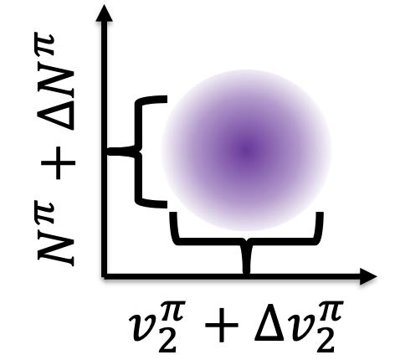
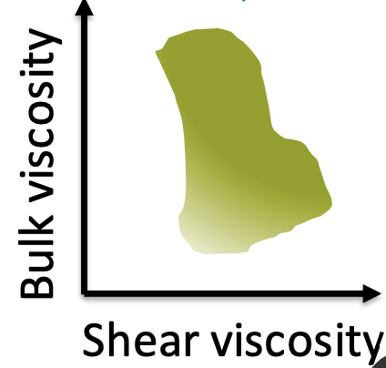
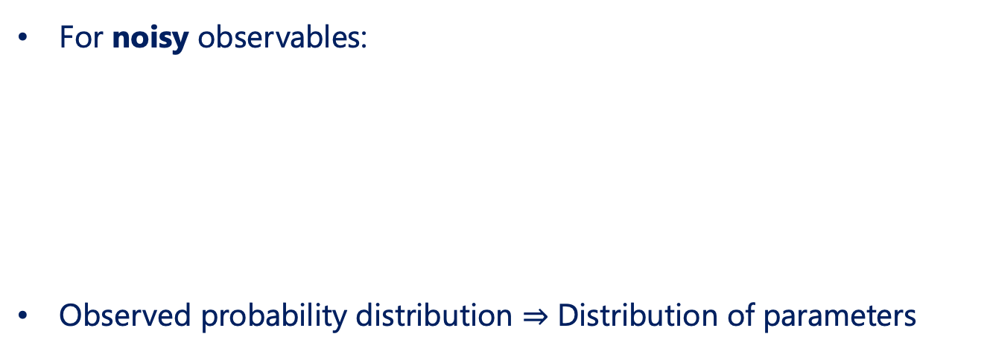
Inverse Problem
Model Parameters
(Model)⁻¹
Outputs (Observables)
For noisy observables:
Observed probability distribution $⇒$ Distribution of parameters

Slide 7
Outline
Forward Problem
Inverse Problem
Bayes’ Rule

Slide 8

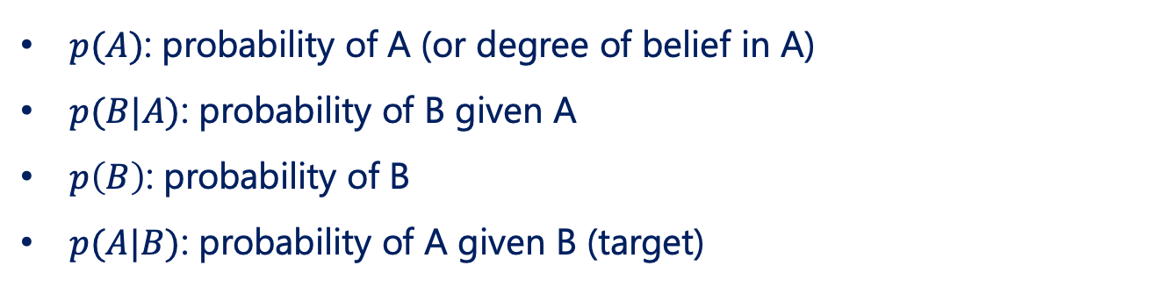
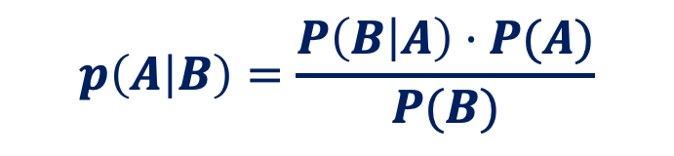
Bayes’ Rule
$$p\left(A | B\right)=\frac{P\left(B | A\right)⋅P(A)}{P(B)}$$
https://www.elmhurst.edu/blog/thomas-bayes/
$p(A)$: probability of A (or degree of belief in A)
$p(B|A)$: probability of B given A
$p\left(B\right)$: probability of B
$p(A|B)$: probability of A given B (target)

Slide 9
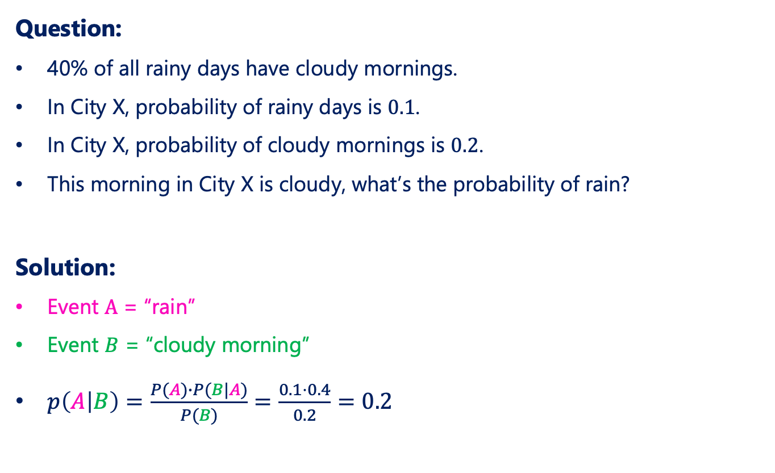
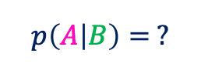
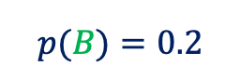

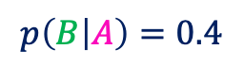
Bayes’ Rule: A Simple Example
Question:
40% of all rainy days have cloudy mornings.
In City X, probability of rainy days is $0.1$.
In City X, probability of cloudy mornings is $0.2$.
This morning in City X is cloudy, what’s the probability of rain?
Solution:
Event $A$ = “rain”
Event $B$ = “cloudy morning”
$p\left(A | B\right)=\frac{P(A)∙P(B|A)}{P(B)}=\frac{0.1⋅0.4}{0.2}=0.2$
$$p\left(B | A\right)=0.4$$
$$p(A)=0.1$$
$$p(B)=0.2$$
$$p\left(A | B\right)= ?$$

Slide 10
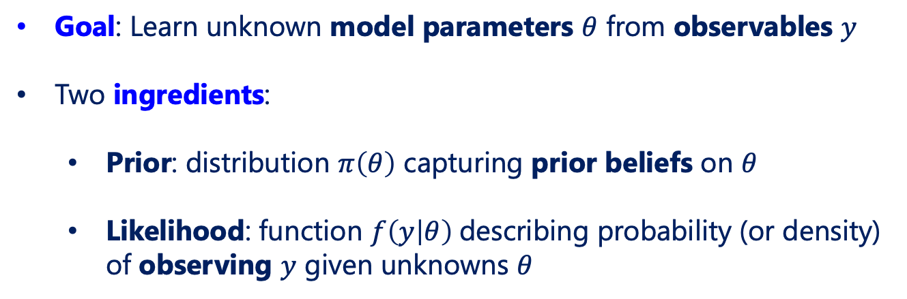
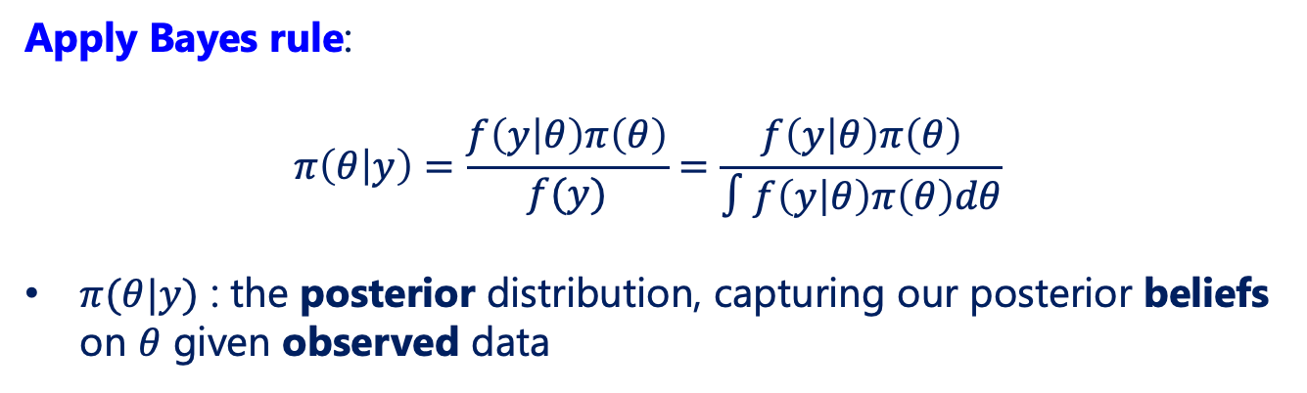
Bayes’ Rule for Parameter Estimation
Goal: Learn unknown model parameters $θ$ from observables $y$
Two ingredients:
Prior: distribution $π\left(θ\right)$ capturing prior beliefs on $θ$
Likelihood: function $f\left(y | θ\right)$describing probability (or density) of observing $y$ given unknowns $θ$
Apply Bayes rule:
$$π\left(θ | y\right)=\frac{f\left(y | θ\right)π\left(θ\right)}{f(y)}=\frac{f\left(y | θ\right)π\left(θ\right)}{∫f\left(y | θ\right)π\left(θ\right)dθ}$$
$π(θ|y)$ : the posterior distribution, capturing our posterior beliefs on $θ$ given observed data

Slide 11
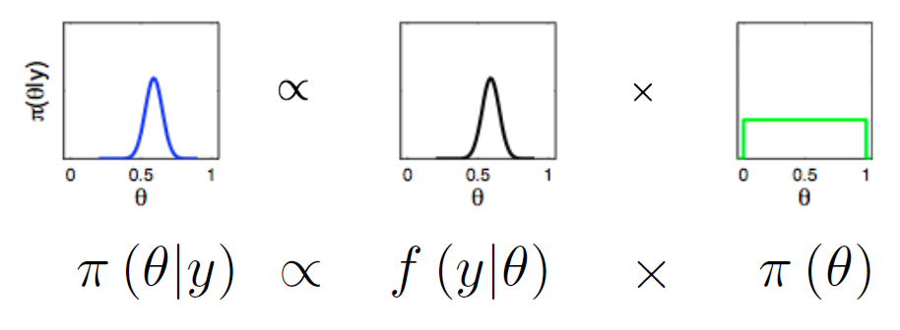
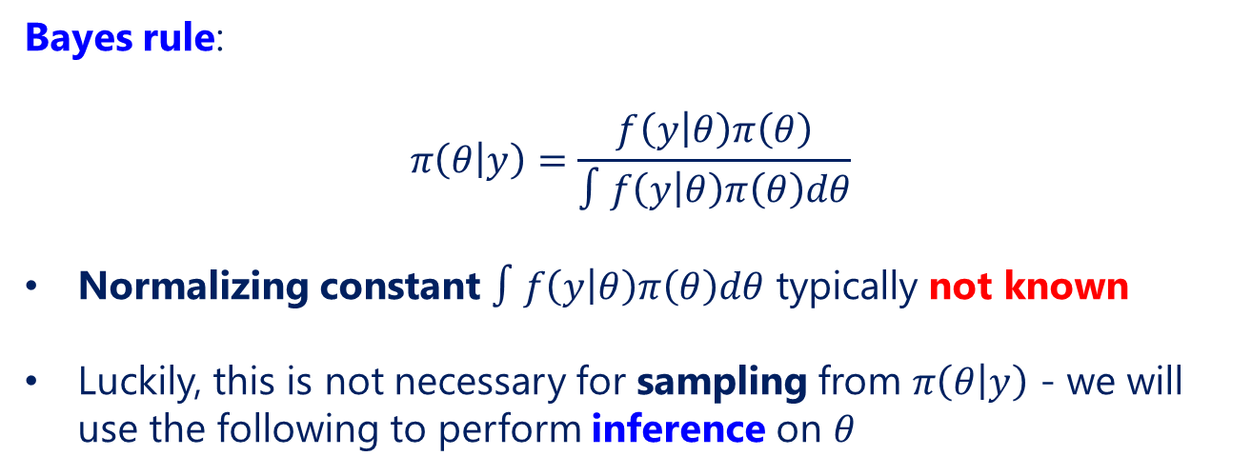
Bayes’ Rule for Parameter Estimation
Bayes rule:
$$π\left(θ | y\right)=\frac{f\left(y | θ\right)π\left(θ\right)}{∫f\left(y | θ\right)π\left(θ\right)dθ}$$
Normalizing constant $∫f\left(y | θ\right)π\left(θ\right)dθ$ typically not known
Luckily, this is not necessary for sampling from $π\left(θ | y\right)$ - we will use the following to perform inference on $θ$

Slide 12
Section II. Bayesian Parameter Estimation

Slide 13
Outline
A Simple Example
Markov Chain Monte Carlo (MCMC)
Bayesian Parameter Estimation

Slide 14
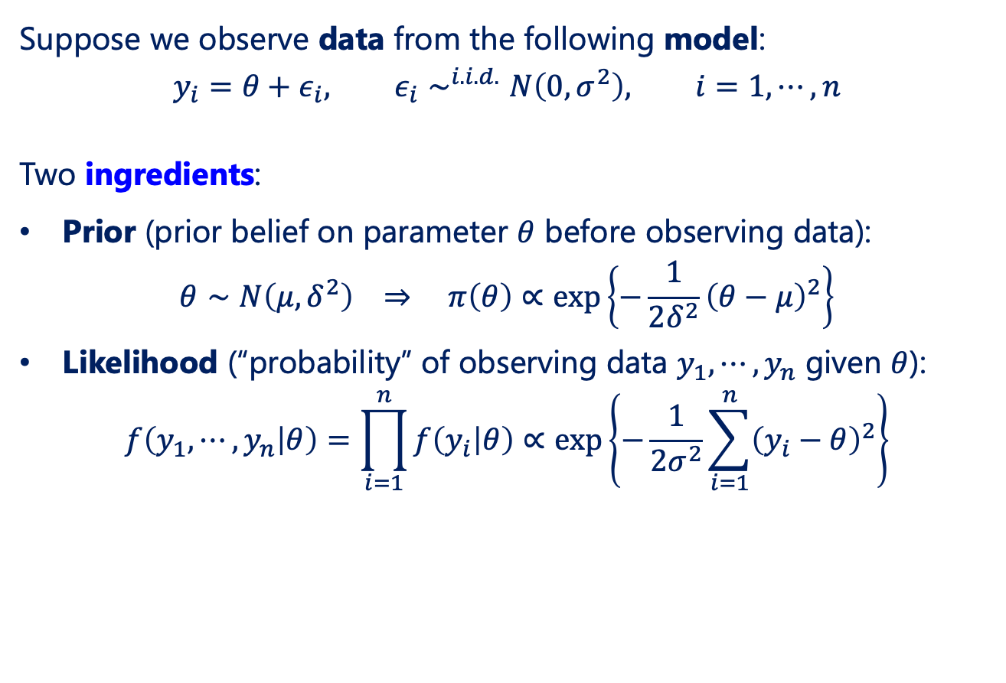
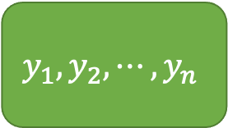

A Simple Example
$$θ$$
$$y_{1},y_{2},⋯,y_{n}$$
Suppose we observe data from the following model:
$$y_{i}=θ+ε_{i}, ε_{i}∼^{i.i.d.}N\left(0,σ^{2}\right), i=1, ⋯, n$$
Two ingredients:
Prior (prior belief on parameter $θ$ before observing data):
$$θ∼N\left(μ,δ^{2}\right) ⇒ π\left(θ\right)∝\exp\left\{−\frac{1}{2δ^{2}}{\left(θ−μ\right)}^{2}\right\}$$
Likelihood (“probability” of observing data $y_{1},⋯, y_{n}$ given $θ$):
$$f\left(y_{1},⋯, y_{n} | θ\right)=\prod_{i=1}^{n}{f\left(y_{i} | θ\right)}∝\exp\left\{−\frac{1}{2σ^{2}}\sum_{i=1}^{n}{{\left(y_{i}−θ\right)}^{2}}\right\}$$

Slide 15
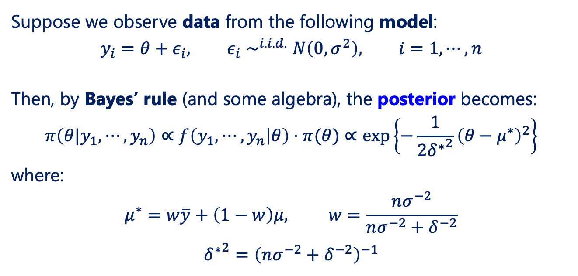
A Simple Example
$$θ$$
$$y_{1},y_{2},⋯,y_{n}$$
Suppose we observe data from the following model:
$$y_{i}=θ+ε_{i}, ε_{i}∼^{i.i.d.}N\left(0,σ^{2}\right), i=1, ⋯, n$$
Then, by Bayes’ rule (and some algebra), the posterior becomes:
$$π\left(θ|y_{1},⋯, y_{n}\right)∝f\left(y_{1},⋯, y_{n} | θ\right)⋅π(θ)∝\exp\left\{−\frac{1}{2{δ^{∗}}^{2}}{\left(θ−μ^{∗}\right)}^{2}\right\}$$
where:
$$μ^{∗}=w\overline{y}+\left(1−w\right)μ, w=\frac{nσ^{−2}}{nσ^{−2}+δ^{−2}}$$
$${δ^{∗}}^{2}={\left(nσ^{−2}+δ^{−2}\right)}^{−1}$$

Slide 16
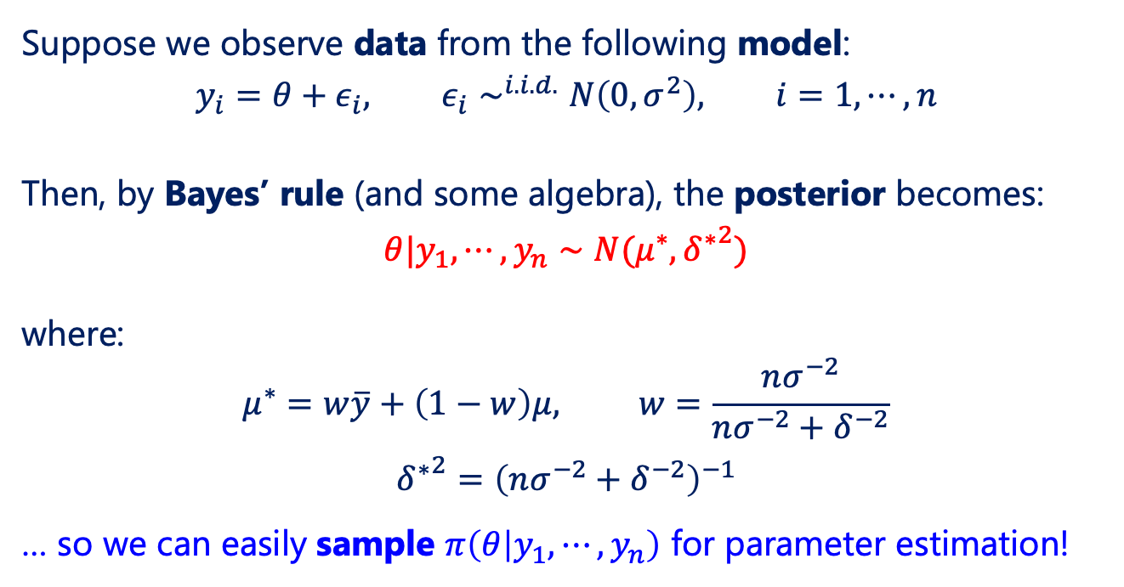
A Simple Example
$$θ$$
$$y_{1},y_{2},⋯,y_{n}$$
Suppose we observe data from the following model:
$$y_{i}=θ+ε_{i}, ε_{i}∼^{i.i.d.}N\left(0,σ^{2}\right), i=1, ⋯, n$$
Then, by Bayes’ rule (and some algebra), the posterior becomes:
$$θ|y_{1},⋯, y_{n}∼N(μ^{∗},{δ^{∗}}^{2})$$
where:
$$μ^{∗}=w\overline{y}+\left(1−w\right)μ, w=\frac{nσ^{−2}}{nσ^{−2}+δ^{−2}}$$
$${δ^{∗}}^{2}={\left(nσ^{−2}+δ^{−2}\right)}^{−1}$$
… so we can easily sample $π\left(θ | y_{1},⋯, y_{n}\right)$ for parameter estimation!

Slide 17
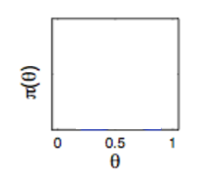
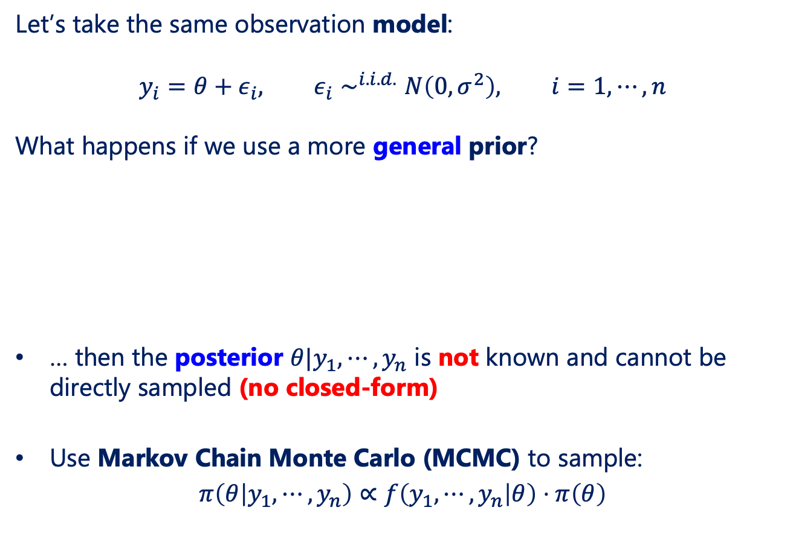
Markov Chain Monte Carlo (MCMC)
Let’s take the same observation model:
$$y_{i}=θ+ε_{i}, ε_{i}∼^{i.i.d.}N\left(0,σ^{2}\right), i=1, ⋯, n$$
What happens if we use a more general prior?
… then the posterior $θ|y_{1},⋯, y_{n}$ is not known and cannot be directly sampled (no closed-form)
Use Markov Chain Monte Carlo (MCMC) to sample:
$$π\left(θ | y_{1},⋯, y_{n}\right)∝f\left(y_{1},⋯, y_{n} | θ\right)⋅π\left(θ\right)$$

Slide 18
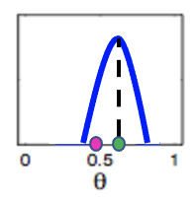
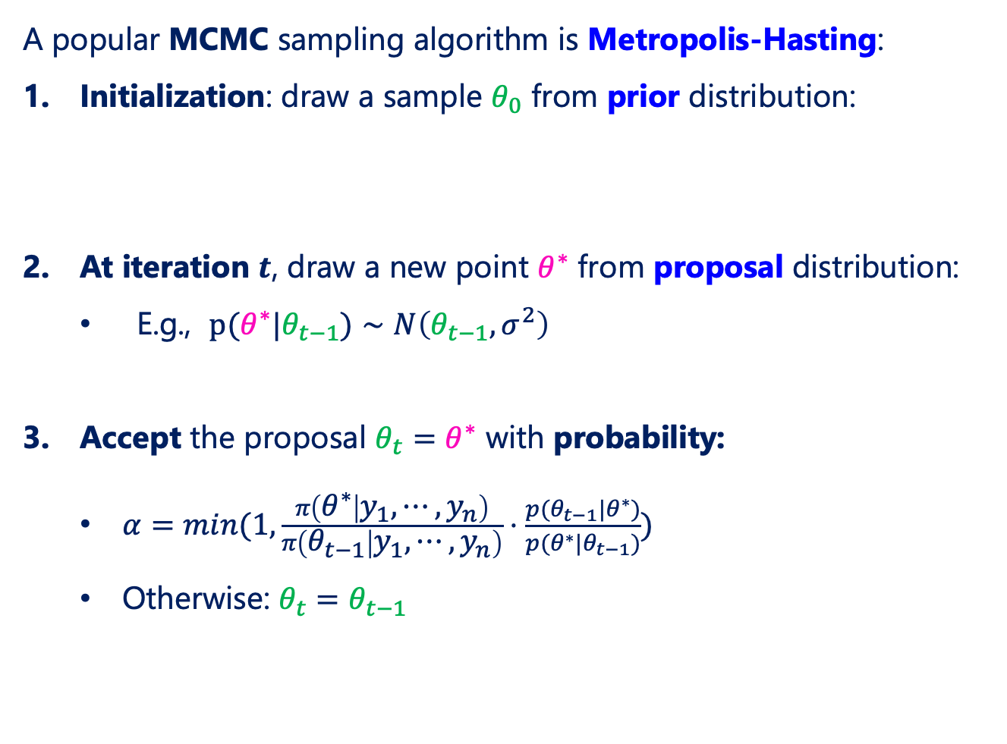
Markov Chain Monte Carlo (MCMC)
A popular MCMC sampling algorithm is Metropolis-Hasting:
Initialization: draw a sample $θ_{0}$ from prior distribution:
At iteration $t$, draw a new point $θ^{∗}$ from proposal distribution:
E.g., $p(θ^{∗}|θ_{t−1})∼N\left(θ_{t−1}, σ^{2}\right)$
Accept the proposal $θ_{t}=θ^{∗}$ with probability:
$α=min(1,\frac{π\left(θ^{∗} | y_{1},⋯, y_{n}\right)}{π\left(θ_{t−1} | y_{1},⋯, y_{n}\right)}⋅\frac{p(θ_{t−1}|θ^{∗})}{p(θ^{∗}|θ_{t−1})})$
Otherwise: $θ_{t}=θ_{t−1}$

Slide 19
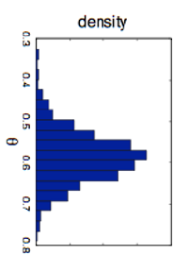
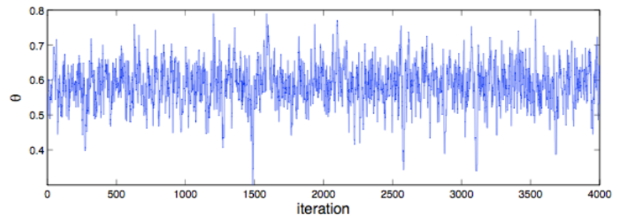
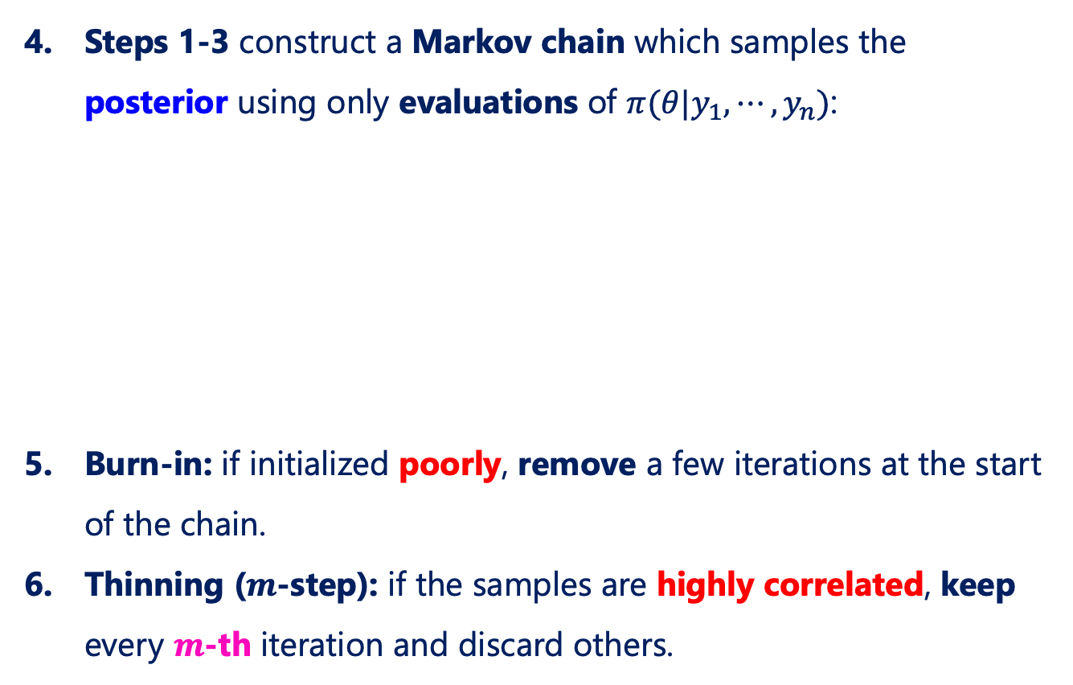

Markov Chain Monte Carlo (MCMC)
Steps 1-3 construct a Markov chain which samples the posterior using only evaluations of $π(θ|y_{1},⋯, y_{n})$:
Burn-in: if initialized poorly, remove a few iterations at the start of the chain.
Thinning ($m$-step): if the samples are highly correlated, keep every $m$-th iteration and discard others.
$m$ steps
Target Posterior

Slide 20
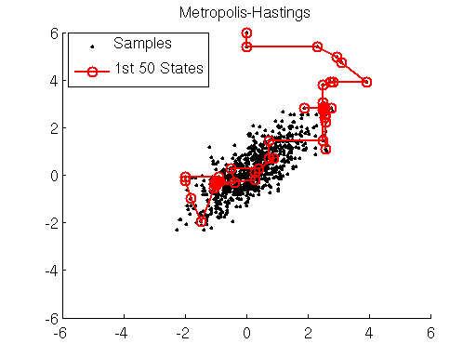
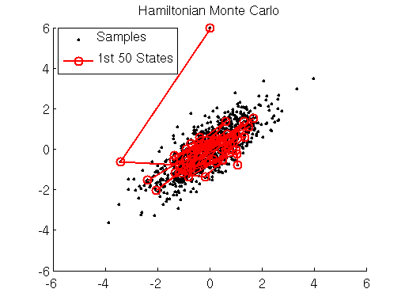
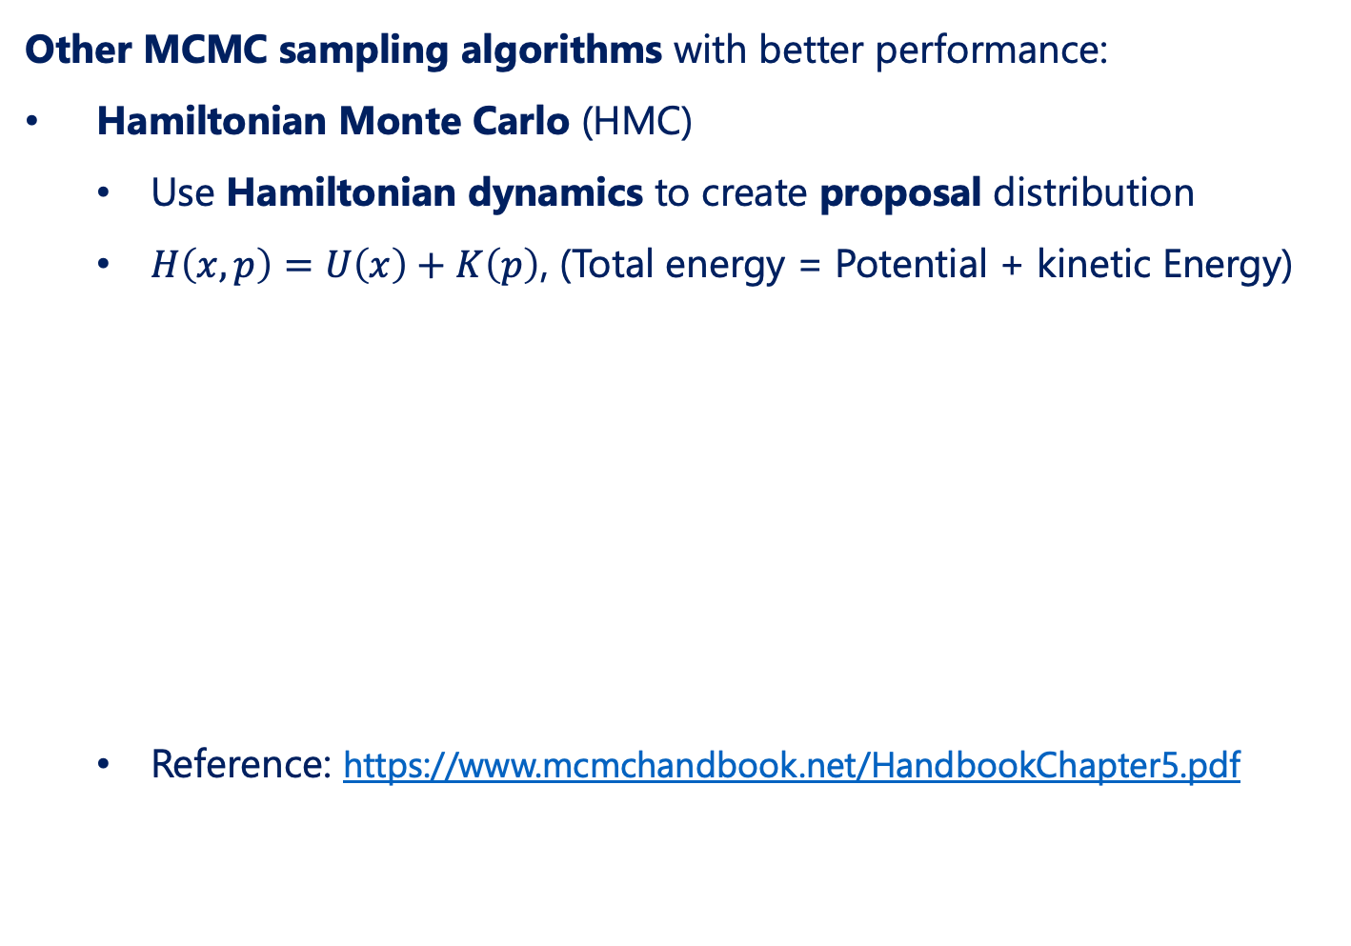
Markov Chain Monte Carlo (MCMC)
Other MCMC sampling algorithms with better performance:
Hamiltonian Monte Carlo (HMC)
Use Hamiltonian dynamics to create proposal distribution
$H\left(x,p\right)=U\left(x\right)+K\left(p\right)$, (Total energy = Potential + kinetic Energy)
Reference: https://www.mcmchandbook.net/HandbookChapter5.pdf
Faster convergence with better mixing
Figures: https://theclevermachine.wordpress.com/2012/11/18/mcmc-hamiltonian-monte-carlo-a-k-a-hybrid-monte-carlo/

Slide 21
Markov Chain Monte Carlo (MCMC)
Other MCMC sampling algorithms with better performance:
Affine-invariant ensemble sampler for MCMC
Performs affine transformation
Better performance in general
Implemented in Python package ”emcee” (Hands-on Session): https://emcee.readthedocs.io/en/stable/
Reference: https://arxiv.org/pdf/1202.3665.pdf
Parallel-tempered MCMC
Good performance for multi-modal posterior distribution
Implemented in JETSCAPE-SIMS package
Reference: https://emcee.readthedocs.io/en/v2.2.1/user/pt/

Slide 22
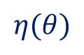

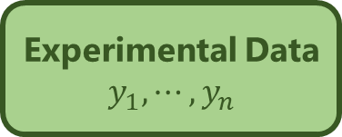
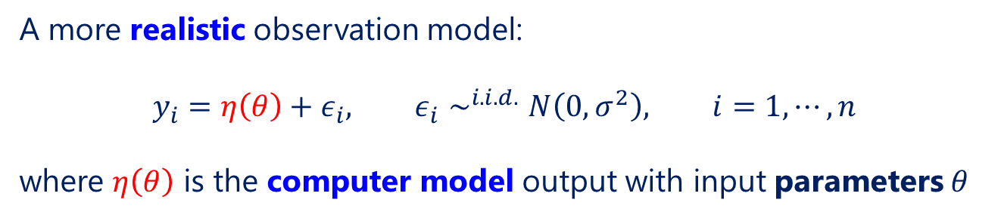
Parameter Estimation
A more realistic observation model:
$$y_{i}=η\left(θ\right)+ε_{i}, ε_{i}∼^{i.i.d.}N\left(0,σ^{2}\right), i=1, ⋯, n$$
where $η\left(θ\right)$ is the computer model output with input parameters $θ$
Experimental Data
$$y_{1}, ⋯, y_{n}$$
Computer Simulator
Parameter Estimation
$$θ$$
$$η(θ)$$

Slide 23
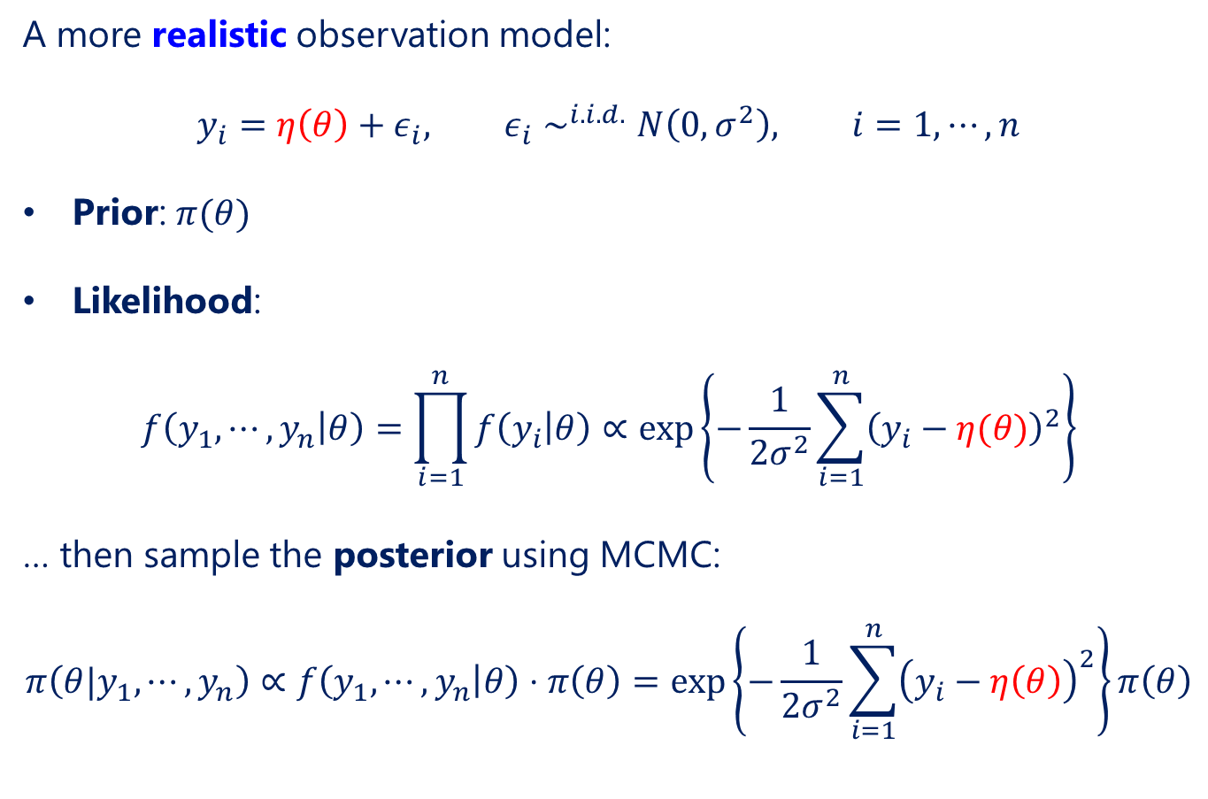
Parameter Estimation
A more realistic observation model:
$$y_{i}=η\left(θ\right)+ε_{i}, ε_{i}∼^{i.i.d.}N\left(0,σ^{2}\right), i=1, ⋯, n$$
Prior: $π(θ)$
Likelihood:
$$f\left(y_{1},⋯, y_{n} | θ\right)=\prod_{i=1}^{n}{f\left(y_{i} | θ\right)}∝\exp\left\{−\frac{1}{2σ^{2}}\sum_{i=1}^{n}{{\left(y_{i}−η(θ)\right)}^{2}}\right\}$$
… then sample the posterior using MCMC:
$$π\left(θ|y_{1},⋯, y_{n}\right)∝f\left(y_{1},⋯, y_{n} | θ\right)⋅π\left(θ\right)=\exp\left\{−\frac{1}{2σ^{2}}\sum_{i=1}^{n}{{\left(y_{i}−η\left(θ\right)\right)}^{2}}\right\}π\left(θ\right)$$

Slide 24
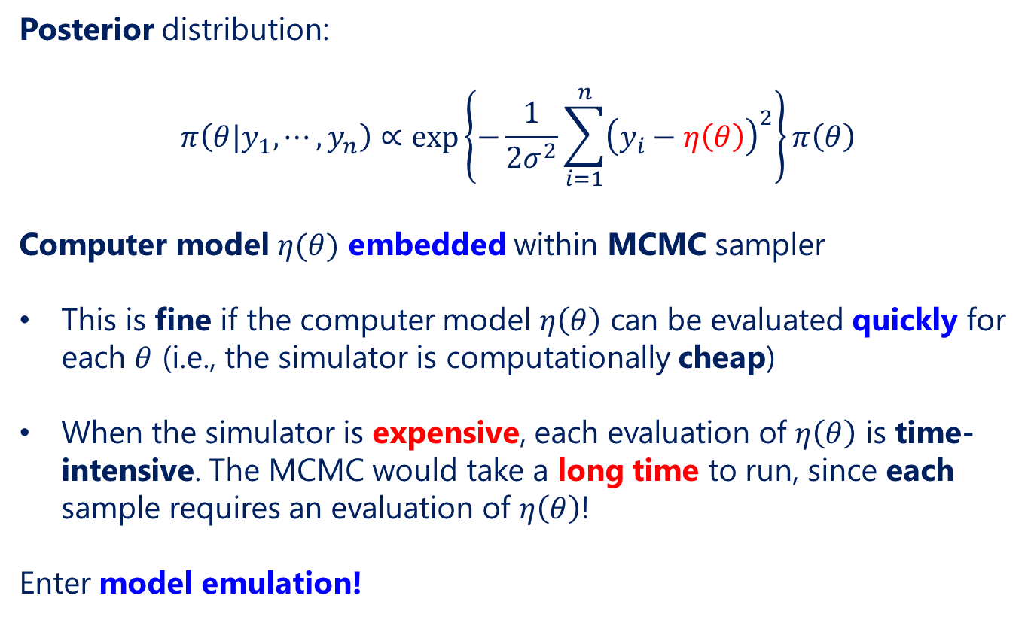
A More Realistic Model
Posterior distribution:
$$π\left(θ|y_{1},⋯, y_{n}\right)∝\exp\left\{−\frac{1}{2σ^{2}}\sum_{i=1}^{n}{{\left(y_{i}−η\left(θ\right)\right)}^{2}}\right\}π\left(θ\right)$$
Computer model $η(θ)$ embedded within MCMC sampler
This is fine if the computer model $η\left(θ\right)$ can be evaluated quickly for each $θ$ (i.e., the simulator is computationally cheap)
When the simulator is expensive, each evaluation of $η\left(θ\right)$ is time-intensive. The MCMC would take a long time to run, since each sample requires an evaluation of $η\left(θ\right)$!
Enter model emulation!

Slide 25
Section III. Computer Model Emulation

Slide 26
Outline
Model Emulation
Gaussian Process
Multiple Observables
Principal Component Analysis
Bayesian Inference Workflow

Slide 27
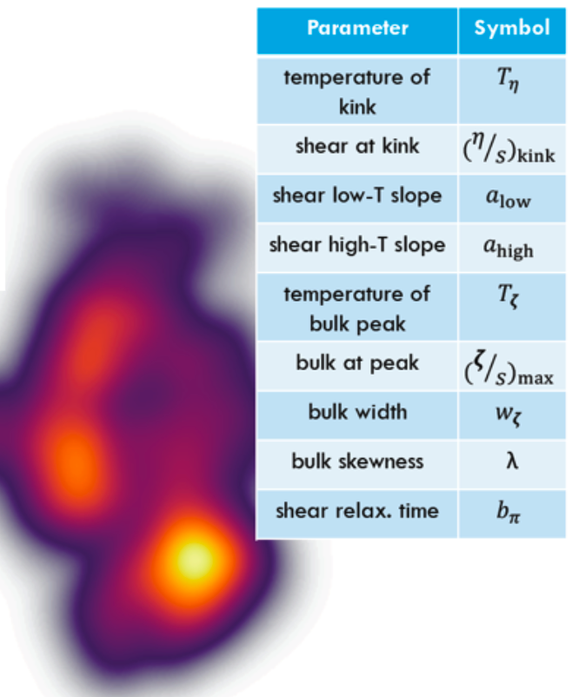
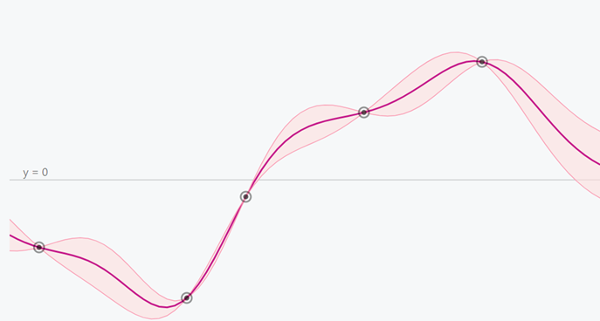

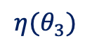
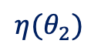

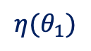
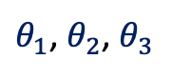
Model Emulation
One way to speed up computer simulations is via model emulation:
$${η(θ}_{3})$$
$${η(θ}_{2})$$
$${η(θ}_{1})$$
$$θ$$
$θ_{1}$, $θ_{2}$, $θ_{3}$
$$θ_{new}$$
Run a few simulations at different parameters
Train a predictive model using simulation data
Predict simulation output at a new parameter

Slide 28
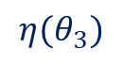
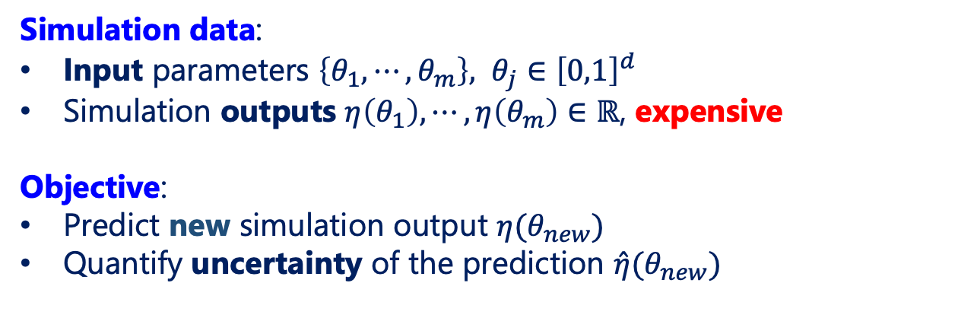
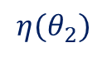


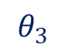
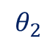
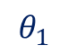
Model Emulation
$${η(θ}_{3})$$
$${η(θ}_{1})$$
$${η(θ}_{2})$$
$$θ_{1}$$
$$θ_{2}$$
$$θ_{3}$$
$$θ_{new}$$
Simulation data:
Input parameters $\left\{θ_{1},⋯, θ_{m}\right\}, θ_{j}∈{\left[0,1\right]}^{d}$
Simulation outputs $η\left(θ_{1}\right),⋯, η\left(θ_{m}\right)∈ℝ$, expensive
Objective:
Predict new simulation output $η(θ_{new})$
Quantify uncertainty of the prediction $\hat{η}(θ_{new})$

Slide 29
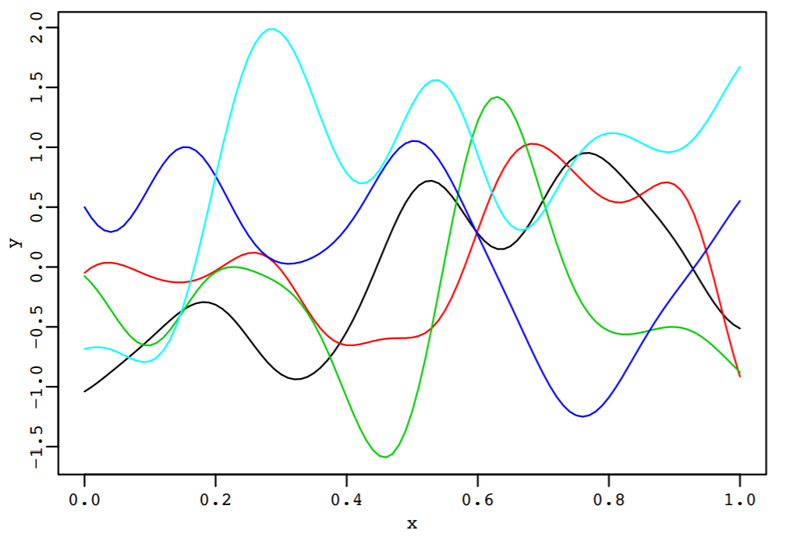
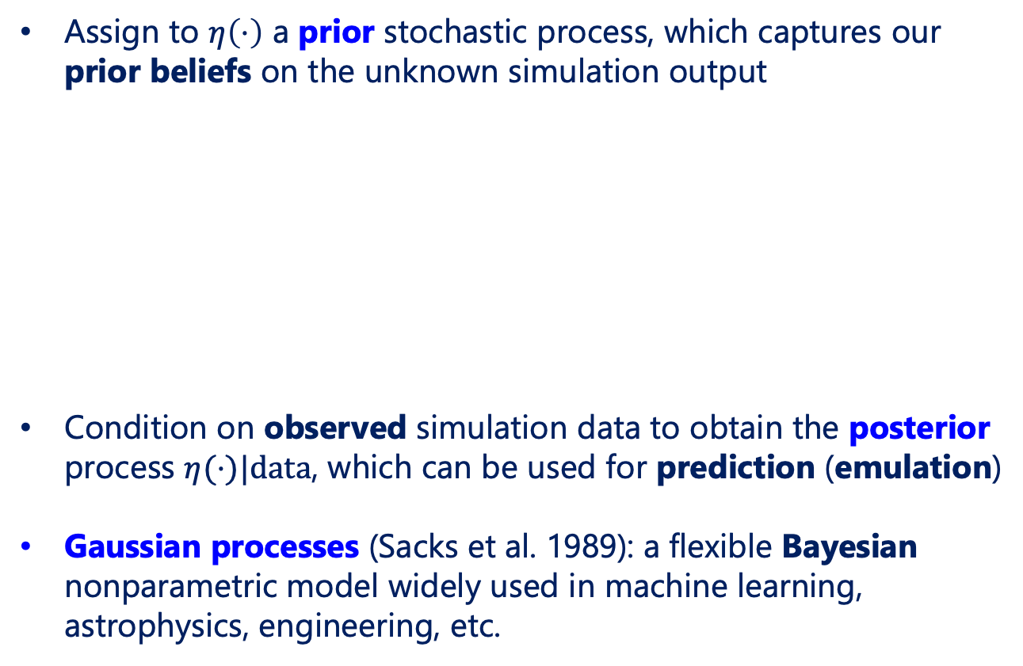
Bayesian Predictive Modeling
Assign to $η\left(⋅\right)$ a prior stochastic process, which captures our prior beliefs on the unknown simulation output
Condition on observed simulation data to obtain the posterior process $η(⋅)|data$, which can be used for prediction (emulation)
Gaussian processes (Sacks et al. 1989): a flexible Bayesian nonparametric model widely used in machine learning, astrophysics, engineering, etc.

Slide 30

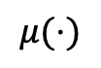
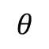
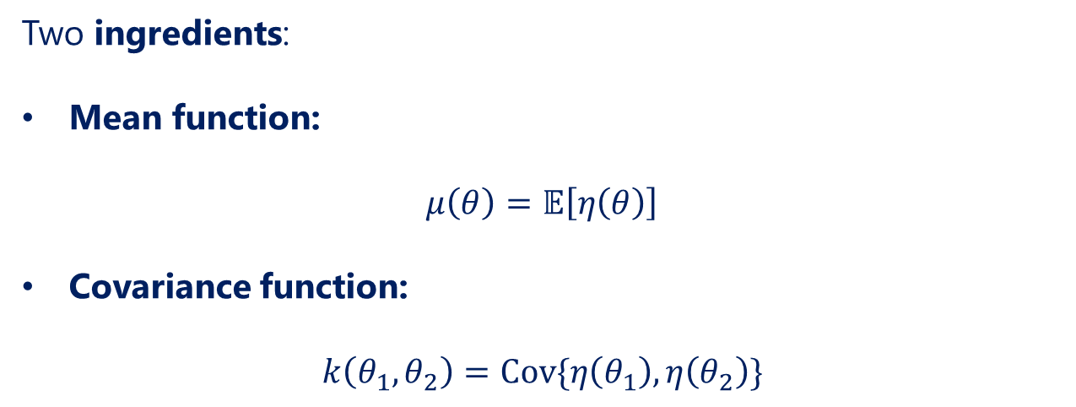
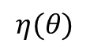


Gaussian Processes
Gaussian process (GP) prior model:
$$η\left(⋅\right)∼GP\left(μ\left(⋅\right),k\left(⋅,⋅\right)\right)$$
Two ingredients:
Mean function:
$$μ\left(θ\right)=𝔼\left[η\left(θ\right)\right]$$
Covariance function:
$$k\left(θ_{1},θ_{2}\right)=Cov\{η\left(θ_{1}\right),η\left(θ_{2}\right)\}$$
$$θ_{1}$$
$$θ_{2}$$
$$η(θ)$$
$$μ(⋅)$$
$$θ$$

Slide 31










Gaussian Processes
Conditioning on simulation data:
Prior: $η\left(⋅\right)∼GP(μ,k(⋅,⋅))$
$$η(θ)$$
Posterior: $η\left(⋅\right)|data$
$$θ$$

Slide 32






Gaussian Processes
Posterior mean
$$\hat{η}(θ_{new})$$
$$η\left(θ\right)$$
Data
$$θ_{new}$$
$$θ$$
Emulator (posterior process mean) – closed form:
$$\hat{η}\left(θ_{new}\right)=𝔼\left[η\left(θ_{new}\right) | data\right]=μ(θ_{new})+k_{new}^{T}K^{−1}\left(η−μ1\right)$$

Slide 33


Gaussian Processes
Posterior mean
$$\hat{η}(θ_{new})$$
$$η\left(θ\right)$$
Data
Posterior variance
$$s^{2}\left(θ_{new}\right)$$
$$θ_{new}$$
$$θ$$
Uncertainty (posterior process variance) – also closed form:
$$s^{2}\left(θ_{new}\right)=Var\left[η\left(θ_{new}\right) | data\right]=k\left(θ_{new},θ_{new}\right)−{k_{new}^{T}K}^{−1}k_{new}$$

Slide 34

Mean & Covariance Functions
Gaussian process (GP) prior model:
$$η\left(⋅\right)∼GP\left(μ\left(⋅\right),k\left(⋅,⋅\right)\right)$$
Mean function $μ\left(⋅\right)$ often taken to be a constant $μ$
Popular correlation functions in the literature:
Squared-exponential correlation:
$k\left(θ_{1},θ_{2}\right)=γ^{2}\exp\left\{−\sum_{l=1}^{d}{φ_{l}{\left(θ_{1,l}−θ_{2,l}\right)}^{2}}\right\}$
Matérn correlation (Cressie 1991)
Cubic correlation (Santner et al. 2013)
We will go over GP fitting in Hands-on Session

Slide 35



Parameter Estimation with Emulator
Let’s integrate this emulator for parameter estimation:
Posterior distribution:
Simulator $η\left(θ\right)$ expensive, want to replace with emulator $\hat{η}\left(θ\right)$
But the emulator has predictive uncertainty as well:
$s^{2}\left(θ_{new}\right)=Var\left[η\left(θ_{new}\right) | data\right]$ from GP emulator
Integrate this predictive uncertainty within the likelihood
$$π\left(θ|y_{1},⋯, y_{n}\right)∝\frac{1}{\sqrt{2πσ^{2}}}\exp\left\{−\frac{1}{2σ^{2}}\sum_{i=1}^{n}{{\left(y_{i}−\hat{η}\left(θ\right)\right)}^{2}}\right\}π\left(θ\right)$$
$$π\left(θ|y_{1},⋯, y_{n}\right)∝\frac{1}{\sqrt{2πσ^{2}}}\exp\left\{−\frac{1}{2σ^{2}}\sum_{i=1}^{n}{{\left(y_{i}−η\left(θ\right)\right)}^{2}}\right\}π\left(θ\right)$$
$$π\left(θ|y_{1},⋯, y_{n}\right)∝\frac{1}{\sqrt{2π{{σ^{∗}}^{2}\left(θ\right)}^{2}}}\exp\left\{−\frac{1}{2{{σ^{∗}}^{2}\left(θ\right)}^{2}}\sum_{i=1}^{n}{{\left(y_{i}−\hat{η}\left(θ\right)\right)}^{2}}\right\}π\left(θ\right), { σ^{∗}}^{2}(θ)=σ^{2}+s^{2}\left(θ\right)$$

Slide 36
Parameter Estimation with Emulator
Let’s integrate this emulator for parameter estimation:
Posterior distribution:
We can use this modified posterior (which integrates the emulator) within MCMC sampling
Efficient parameter estimation for expensive computer models
$$π\left(θ|y_{1},⋯, y_{n}\right)∝\frac{1}{\sqrt{2π{{σ^{∗}}^{2}\left(θ\right)}^{2}}}\exp\left\{−\frac{1}{2{{σ^{∗}}^{2}\left(θ\right)}^{2}}\sum_{i=1}^{n}{{\left(y_{i}−\hat{η}\left(θ\right)\right)}^{2}}\right\}π\left(θ\right), { σ^{∗}}^{2}\left(θ\right)=σ^{2}+s^{2}\left(θ\right)$$

Slide 37
Outline
Model Emulation
Gaussian Process
Multiple Observables
Principal Component Analysis
Bayesian Inference Workflow

Slide 38

Principal Component Analysis (PCA)
Problem: model $M$ correlated observables jointly
One solution (dimension reduction):
convert to $k≪M$ independent (transformed) outputs
model them independently
Method: Principal Component Analysis (PCA)
Finds directions with maximum variances (contain most information of data) and project data onto these directions

Slide 39

Principal Component Analysis (PCA)
Principal Components (PC):
a few linearly uncorrelated coordinates
PCA:
a linear transformation of observables that defines a new coordinate rule:
1st PC: highest projected variance
2nd PC: second highest projected variance, orthogonal (perpendicular) to 1st PC
…
Figure source: https://en.wikipedia.org/wiki/Principal_component_analysis

Slide 40


A Simple Example (Iris Dataset)
Iris data:
$n=150$ iris flowers, classified as 3 types (red, green, blue)
$M=4$ measurements (observables) for each flower
Visualizing pairwise correlations of 4 observables

Slide 41



A Simple Example (Iris Dataset)
Perform PCA:
First 2 PCs (PC1, PC2) explains 95.81% of total variance
Keep PC1 and PC2, discard PC3 and PC4
First 2 PCs conveys almost all information contained in data
$⇒$ use for further analysis (e.g., classification, emulation, etc.)

Slide 42

















PCA for Parameter Estimation
Data:
$n$ data points
$M$ observables
$${PC}_{1}$$
$$M×k$$
$${PC}_{2}$$
$V_{k}$ (first $k$ eigenvectors)
$$PC=YV_{k}$$
$$y_{1}$$
.
.
.
$$y_{2}$$
$${PC}_{k}$$
$C$ (covariance matrix)
$Λ$ (eigenvalues)
$V$ (eigenvectors)
.
.
.
$$n×k$$
$$cov(y_{1},…,y_{M})$$
Eigen-decomposition
$$CV=VΛ$$
Sort by eigenvalues (↘︎)
Reduced dimension of observables from $M$ to $k$
Train GP on PCs (independent)
$$y_{M}$$
Matrix $Y$: $n×M$

Slide 43
Outline
Model Emulation
Gaussian Process
Multiple Observables
Principal Component Analysis
Bayesian Inference Workflow

Slide 44















Workflow
1. Dimension reduction via PCA
2. Interpolate each PC by a GP
3. Reconstruct observables
4. Sampling the posterior via MCMC
$$y_{1}$$
$$\hat{y_{1}}$$
$${PC}_{1}$$
$$GP_{1}$$
$$y_{2}$$
$$\hat{y_{2}}$$
$${PC}_{2}$$
$$GP_{2}$$
PCA
PCA⁻¹
MCMC
.
.
.
.
.
.
.
.
.
.
.
.
$${PC}_{k}$$
$$GP_{k}$$
$$y_{M}$$
$$\hat{y_{M}}$$
$$n×k$$
Data $Y$: $n×M$
Predictions $\hat{Y}$: $n×M$

Slide 45

Workflow
Posterior distribution of select parameters in recent JETSCAPE study
Everett et al. (2021):
https://journals.aps.org/prc/pdf/10.1103/PhysRevC.103.054904

Slide 46

Questions

Slide 47
Hands-On Session
We will now go over a pedagogical example for Bayesian parameter estimation in the hands-on session.
Please follow along at:
https://github.com/JETSCAPE/SummerSchool2022/blob/main/Aug02_BayesOverview/20220802%20Hands-on%20Session_Bayesian%20Analysis%20I.ipynb

